Slide 1
Wellness 101

Slide 2
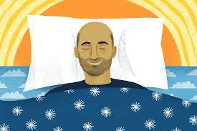
1. Sleep

Slide 3
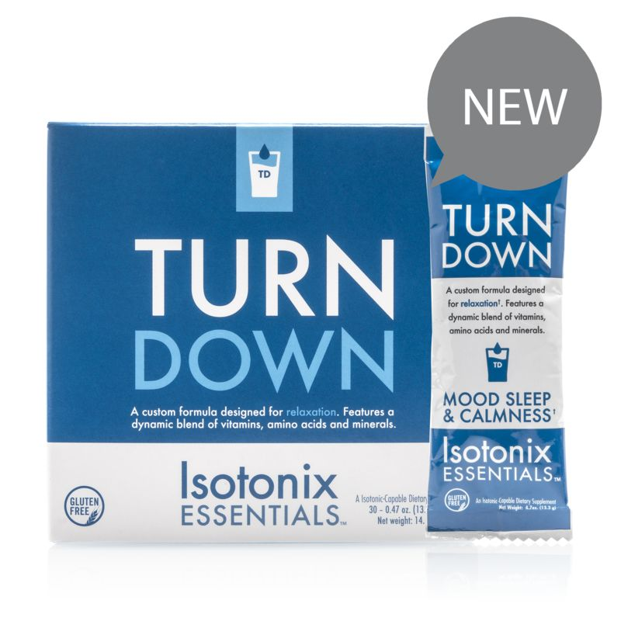
Natural Sleep Aid
Helps enhance and stabilize mood
May promote calmness and relaxation
Supports healthy sleep quality
Promotes sleep
Assists in releasing mental tension
Contains L-Tryptophan and Magnesium
Notes:
Helps promote the deep, restful third and fourth stages of sleep
May improve sleep quality
May have calming properties to help you relax
May help you relax
Sleep deprivation can accelerate the aging process
Adequate and quality sleep can help to prolong the aging process
May help to stabilize mood

Slide 4
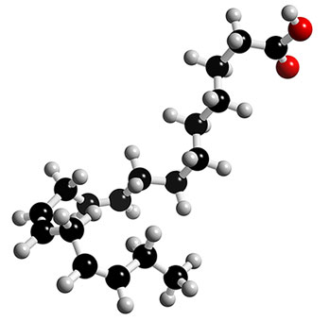
The majority of Americans are deficient
Controls inflammation
May decrease risk of cardiovascular illness and stroke
Improves mood and cognitive health

Slide 5
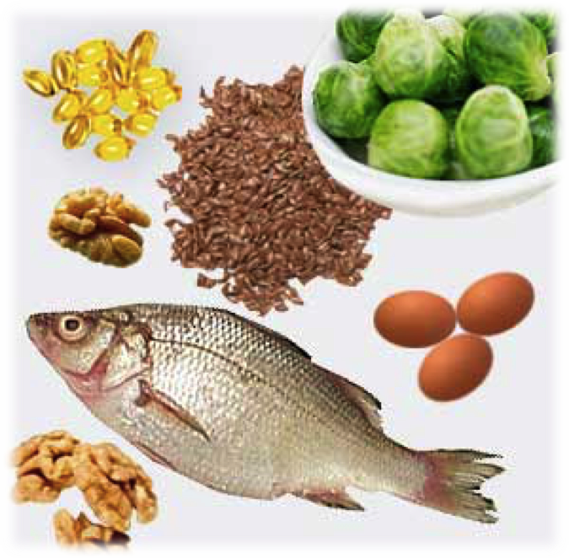
Fatty fish
Nuts
Some eggs
Flax seeds
Olives and olive oil
Avocado
Green leafy veggies
Fish oil supplements

Slide 6
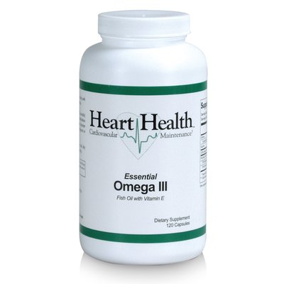
Choosing the Right Fish Oil
Do the math: how much EPA and DHA?
Studies show you need 3 grams to get full benefits
Check purity
Free of toxicity according to standards of US, EU, and Canada.
Notes:
• Helps maintain normal cholesterol levels • Promotes healthy blood pressure levels • Helps maintain normal blood flow • Helps maintain normal triglyceride levels in the blood • Promotes overall cardiovascular health • Helps maintain healthy levels of C-reactive protein • Promotes a healthy complexion • Helps enhance mood

Slide 7
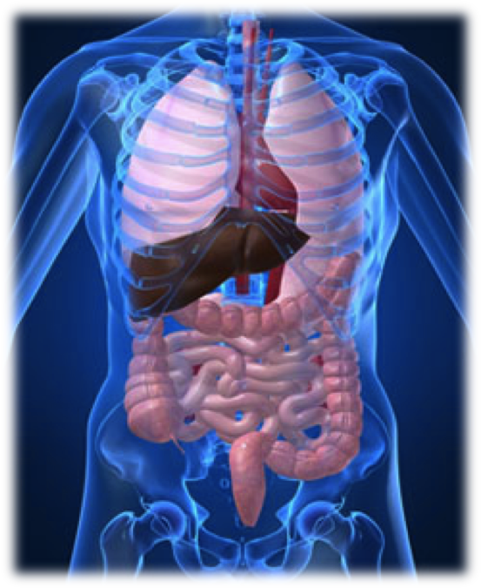
A gentle cleanse is a great way to kick off a new health regimen and/or weight-loss program and to reduce chemical body burden
Choose organic foods when possible
Be careful of harsh or drastic cleanses

Slide 8
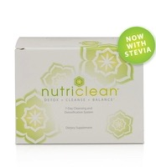
Herbs for liver cleansing
Herbs for bowel cleansing
Fiber
Probiotics
Combine with dietary modifications
Eliminate caffeine, sugar, meat, dairy, wheat

Slide 9
Our food supply stinks
Most Americans are deficient in multiple vitamins and minerals
Vitamins and minerals help our body perform basic metabolic functions.
We need them
Cheapest “health insurance” you can find

Slide 10
The average vegetable found in today's supermarket is anywhere from 5% to 40% lower in minerals (including magnesium, iron, calcium and zinc) than those harvested just 50 years ago.
Donald R. Davis, Biochemical Institute at the University of Texas

Slide 11
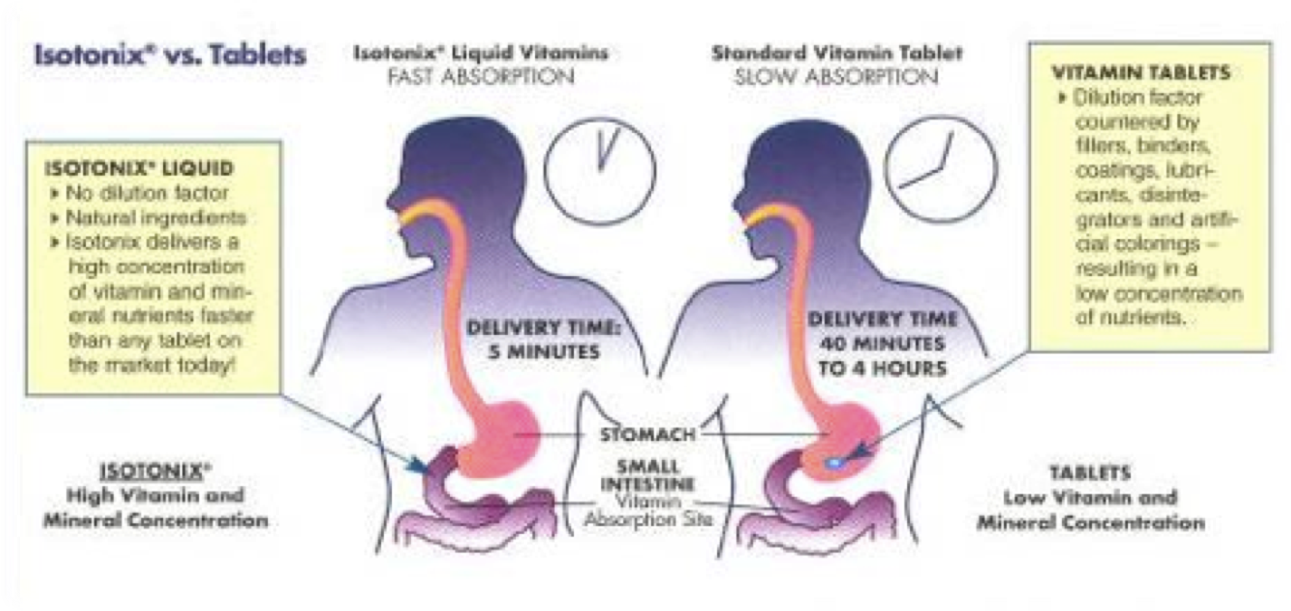
Make Sure It Is Isotonic

Slide 12
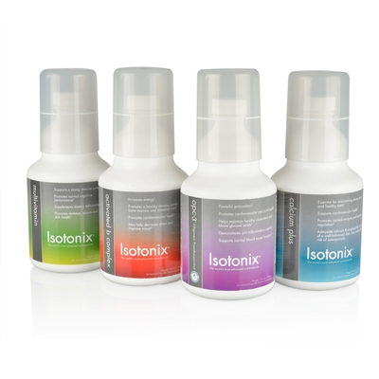
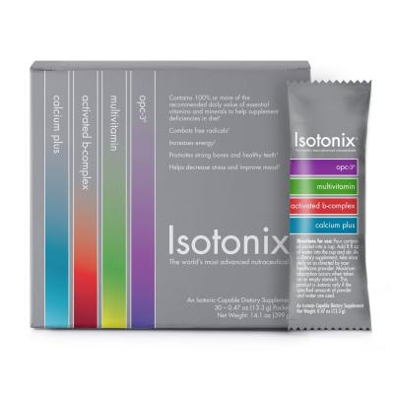

Slide 13
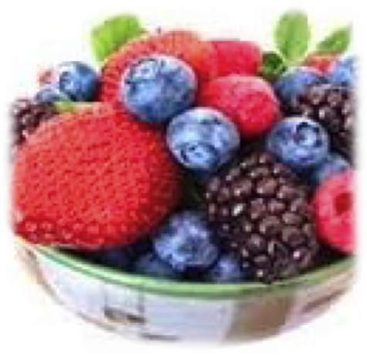
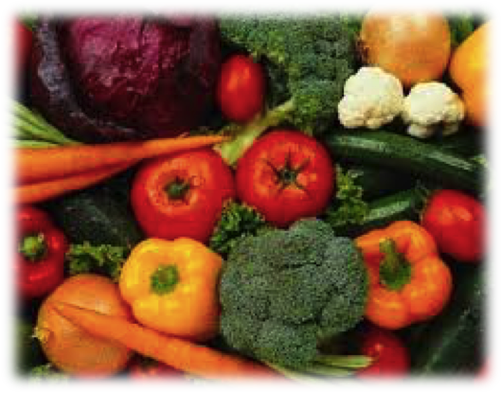
Oxidation = damage by free radicals
Antioxidants protect your cells from damage
Look for foods with a high ORAC value
Eat lots of berries and colorful foods

Slide 14
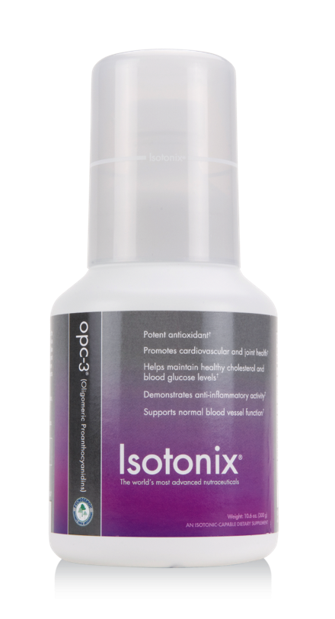
Isotonix OPC-3®

Slide 15
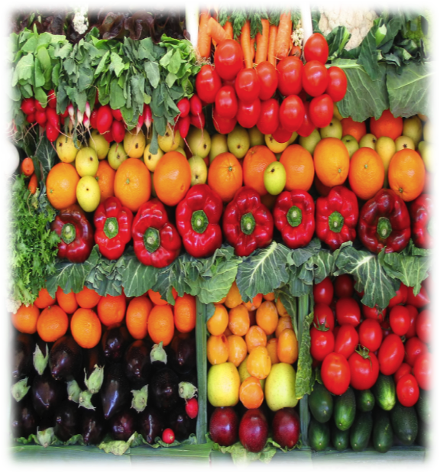
Change your perception of the role veggies play in your diet.
The human diet should be plant-based.
Increase your intake of dark, leafy greens.
Find ways to make this convenient, tasty and fun.

Slide 16
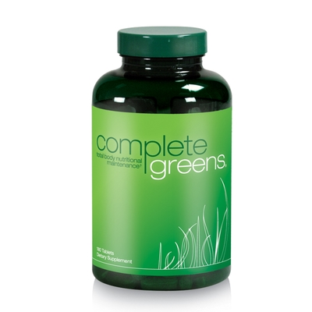
Nutritional equivalent to 8 salads a day
Vegetable and herbal profile
Promotes body cleansing
Boosts energy and vitality
Aids in improving mood
Provides enzymes, nutrients, phytonutrients and probiotics

Slide 17
University of Maryland study found that a sense of humor can protect against heart disease.
It reduces stress
Laughter is the best medicine
Helps maintain a positive outlook

Slide 18
Register as a Preferred Customer
Establish a Follow-Up System
Day 1 - To thank for patronage and inquire about whether they had begun to use
Day 3 – To be sure product is being used properly
Day 7 – Share testimonial
Day 14 – Share testimonial and offer complementary products
Day 21 – Take reorder and get referrals

Slide 19
Build Share of Customer through add-on product sales.
Take time to teach every client about how to find, navigate, and shop through Shop.com.
Drive traffic to your Site.
Tell everyone you know to visit your online business
Review Auto-ship program for monthly reorders

Slide 20
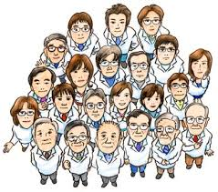
Our professional channel which provides remarkable support and training for effortless retail within a Health Professional office

